Slide 1

PASSWORD VERIFICATION USING PHP AND XAMPP
Project Supervisor: Dr.Mrs.Lalitha
Name of the Student: Endla Sanath Varma
Register Number: 40110347

Slide 2
Presentation Outline
Course Certificate
Introduction
Objectives
Requirements
Project implementation
System Architecture / Identification Map
Result and Discussion
Conclusion
References

Slide 3
Course Certificate
The Certificate is yet to be provided soon by HCL

Slide 4
Introduction
Password Verification system will check the user id and
password is correct or wrong .
If the given password is wrong then there will be a option to
Reset our password by clicking forgotten password.
In the forgotten password page we have to enter our
registered Email id .
From the admin the email will send a reset password link to
your respective mail id.
By clicking that we can reset your password and we can login
to our account

Slide 5
Objectives
The main objective of this project is to detect that password
entered is correct or wrong using PHP and Xampp. If the entered
password is wrong the password reset link is sent to your
registered Email id .
PHP is used to store all our login details and it will save it inside the
database table.(Backend)
HTML is used for the (Frontend) for this project to create login page,
signup page, forgotten password page, password reset page and
home page.
phpmailer is used in this project is to send the mails to the users when they has register a new account a verification mail has been sent to the mail to conform and also when the user want to reset the password.

Slide 6
REQUIREMENTS
PHP - Hypertext Pre-processor
Xampp - Apache, MySQL, PHP, and Perl
Mysql - Structured Query Language
HTML - Hyper Text Markup Language
CSS - Cascading Style Sheets
VS - Visual Studio Code
JS - Java Script

Slide 7
Project Implementation
Once installing, the xampp software in your system set a path for it in enivironmental variable.
Open a xampp app and click the start button to activate apache and mySQL .
Install composer dictonary to your device and activate it in the commond prompt.
Run the project in the browser by clicking the localhost/project name .
Open the phpmyadmin link in the browser and create a table to store all the user details in the table created in the database.

Slide 8
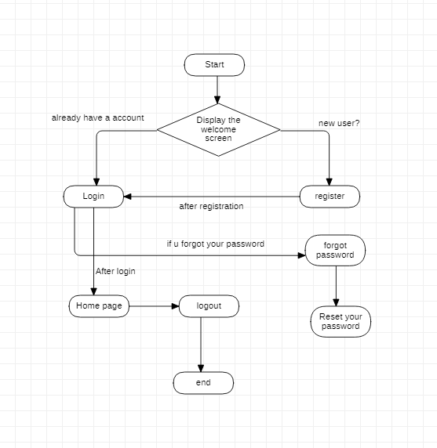
System Architecture of Password Verification
Project outline

Slide 9
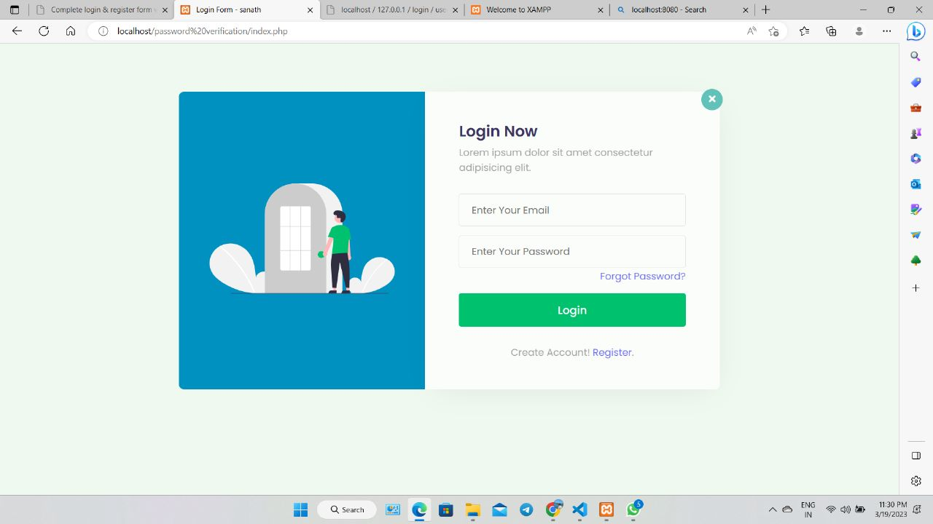
Results and Discussion
Login page
login page where we can give login credentials of email and password to Login into the account

Slide 10
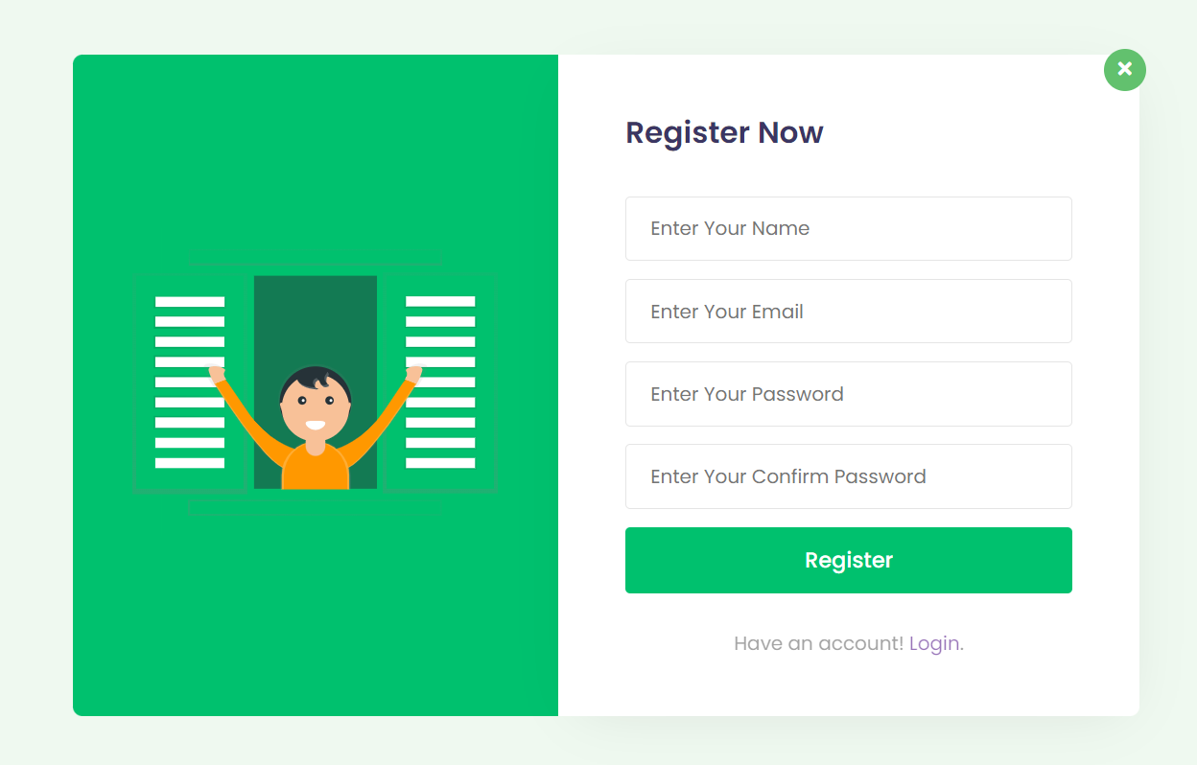
Results and Discussion
Register Page
Sign up page we can see that user can Register by filling the details like
name, email, password, repeat password to open a new account.

Slide 11
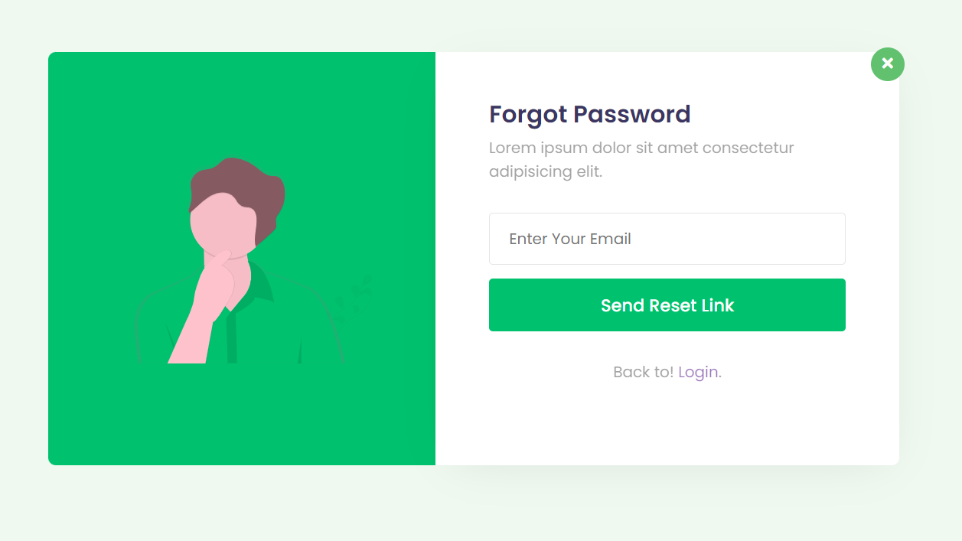
Result and Discussion
Forgot Password Page
In this we can see that when the user forgot their password. by giving the email id to it the user can receive a link through mail to reset the new password.

Slide 12
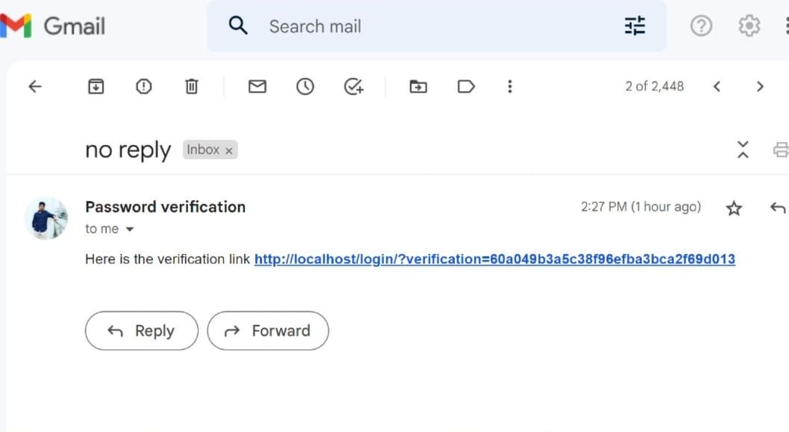
Result and Discussion
Password verification link
In this page, the user will get the verification link through email by clicking on that link it will take to the change password page.

Slide 13
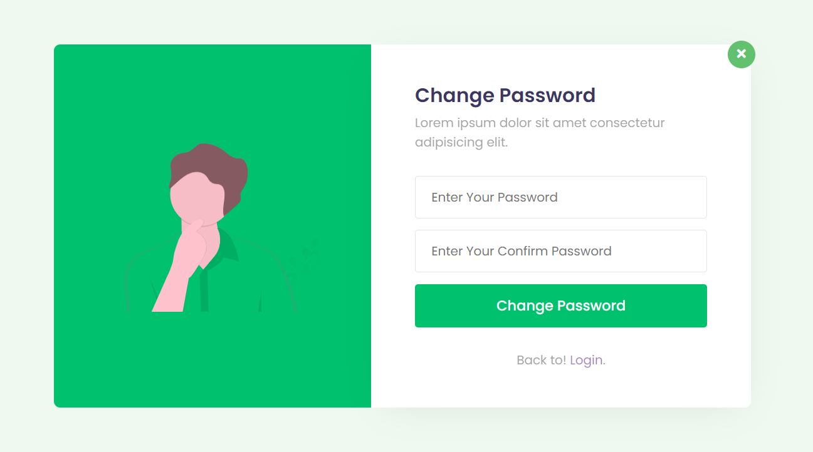
Result and Discussion
Change Password
In this reset password page, we can see that after receiving the link through user’s mail by clicking the link it will take to the reset password page.in this page we can generate the new password.

Slide 14
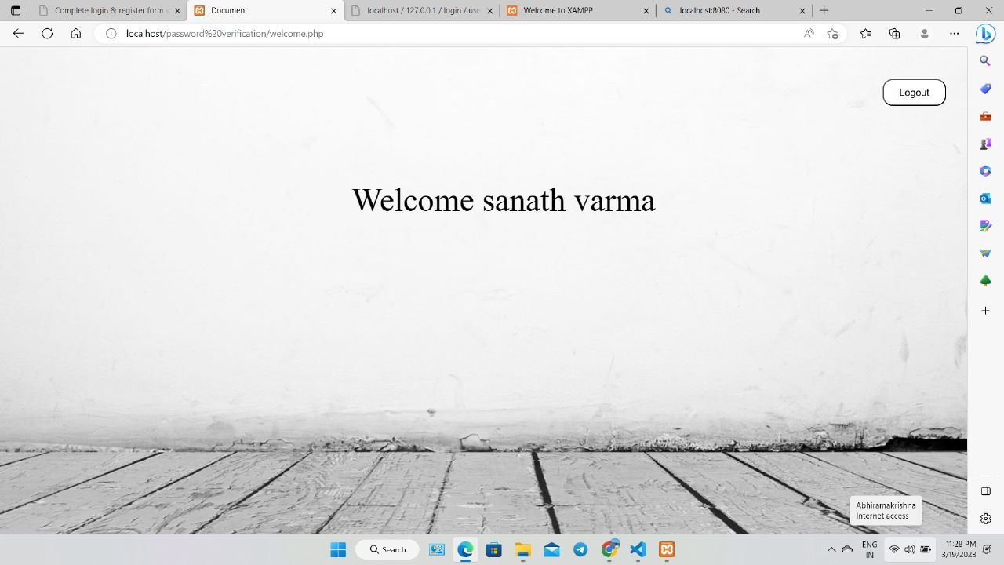
Result and Discussion
Home Page

Slide 15
Conclusion
Many of the website and apps are depend upon the HTML (front end) and to store the data using localhost/phpmyadmin.
without installing the phpmailer we cannot send mail to the any client .
Password verification is about to verify the given password is right or wrong.
CSS is also used for style sheet to design the any website easily.
without xampp we cannot run any of the local host website in the desktop.

Slide 16
References
[1] PHP Documentation https://www.php.net/docs.php [2] HTML & CSS Documentation https://developer.mozilla.org/en-US/ [3] Bootstrap https://getbootstrap.com/ [4] phpmyadmin http://localhost/phpmyadmin/ [5] MySQL Database https://www.codingrooms.com/case-studies [6] Password Verification https://docs.cyberark.com/

Slide 17
THANK YOU

